Slide 1
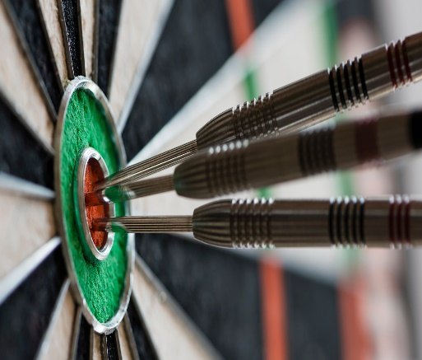
d LUCK OF THE DRAW TOURNAMENT! 50% payout Saturday November 7, 2020 Carroll County Steel Doubles Hosts a benefit In memory of Jason Blair Proceeds to be given to his family
$15 Entry Fee
Open to all
*Double elimination
50/50 Drawing
2900 Baltimore Blvd Finksburg MD 21048
Mike German
443-487-2630
Registration
Starts at 1:00
Luck Starts
at 2:00pm

